Slide 1

What are we going to see in this session?
What is Modules ?
Sample Modules
Where you can find all this modules for reference ?
Finding Module information’s from Command line
Run Commands

Slide 2
What is Modules ?
Modules are programs that Ansible uses to perform operations on managed hosts.
They are ready-to-use tools designed to perform specific operations.
Modules can be executed from the Ansible command line or used in playbooks to execute the tasks.
Three Type of Modules :
Core Modules : These modules are written and maintained by Ansible development team. Core modules are most important modules and are used for common administrative tasks.
Extra Modules : These modules are developed by the community.
Custom Modules : These modules are mostly developed by end users itself.
If a module not already exist for a task, an admin can create by its own which is called custom ones. [Modules are written in Python]

Slide 3

Sample Modules
Ansible ships several hundreds of modules today, some samples are
apt/yum
copy
file
ping
service
git
get_url
shell

Slide 4
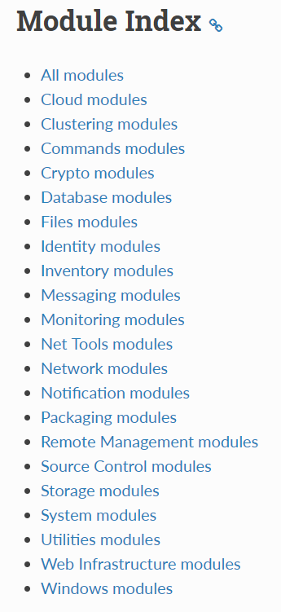
Where you can find all this modules for reference ?
Modules

Slide 5
Finding Module information’s from Command line
You can retrieve all the modules and use case of modules from machine where Ansible is installed.
ansible-doc –l
ansible-doc -l | grep copy
ansible-doc copy

Slide 6
RUN Commands
If Ansible doesn’t have a module that suits your needs there are some “run command” modules.
command: Takes the command and executes it on the host. The most secure and predictable.
shell: Executes through a shell like /bin/sh so you can use pipes etc. Be careful.
script: Runs a local script on a remote node after transferring it.

Slide 7

End of this topic !
Any questions?

